Slide 1
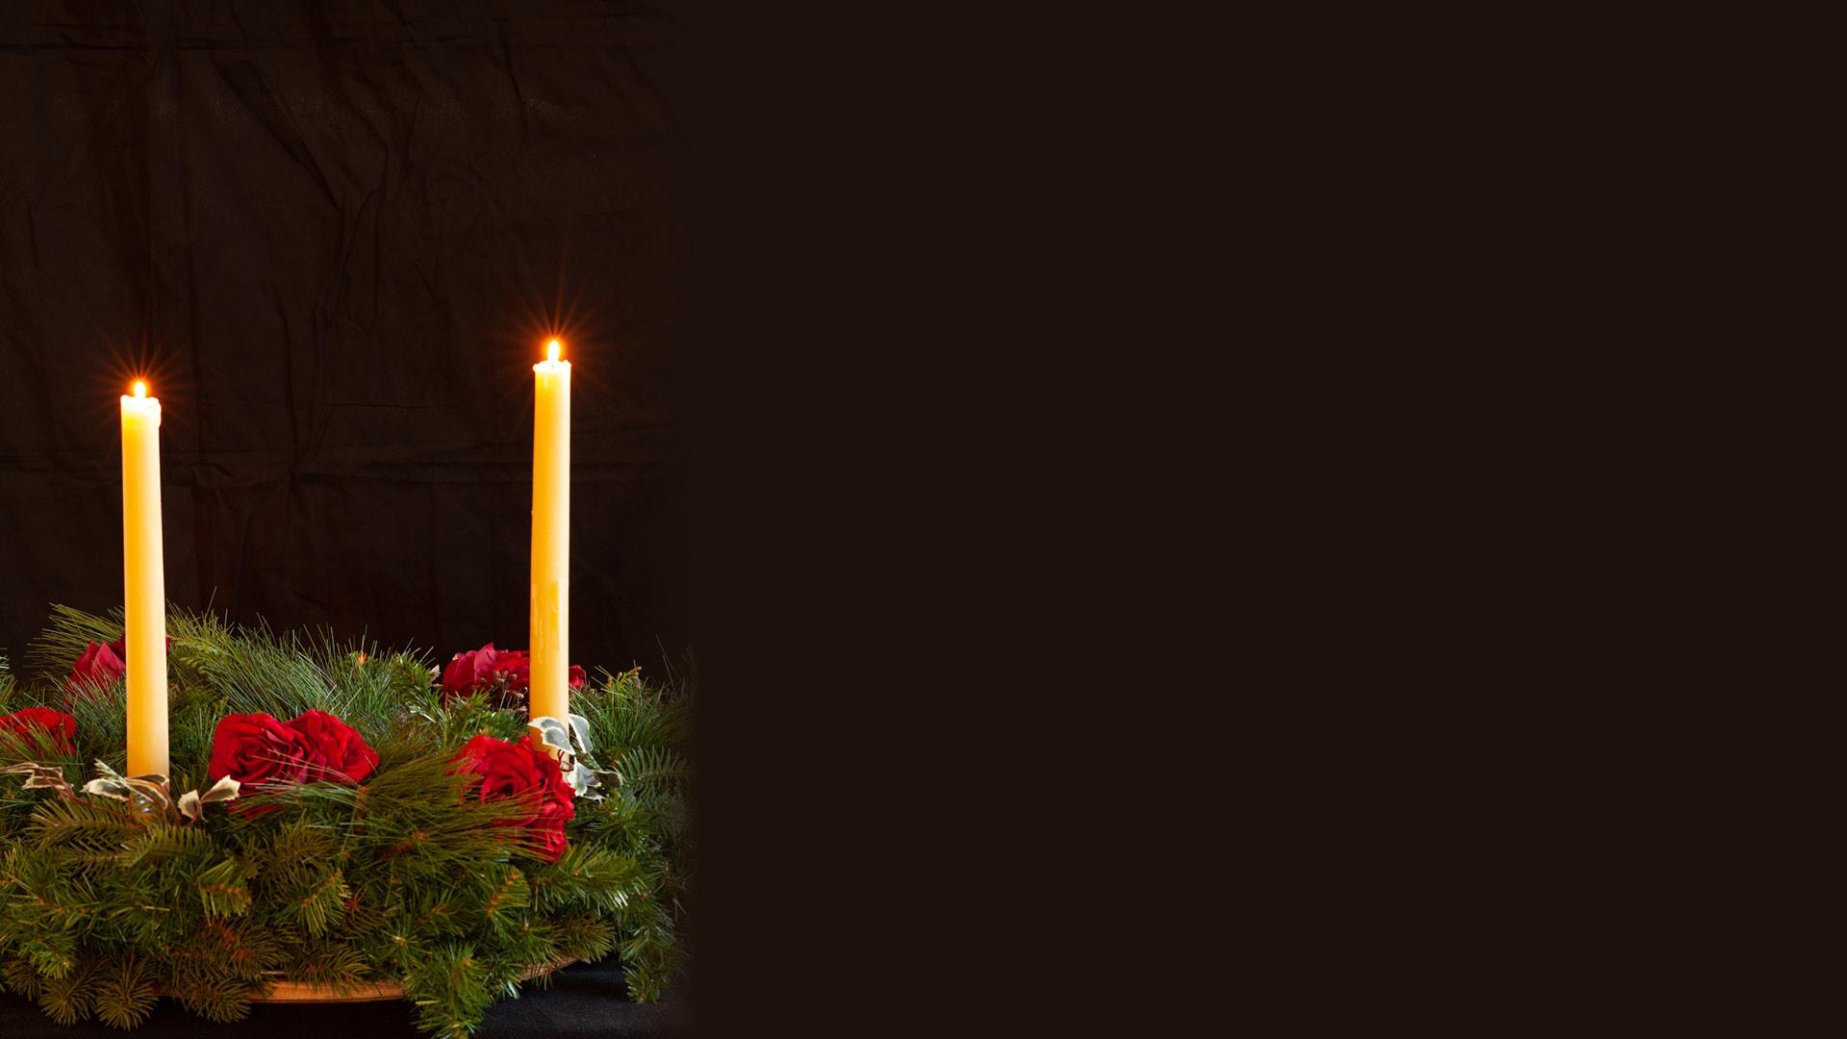
Second Sunday of Advent
PEACE Through
Protecting the Vulnerable

Slide 2
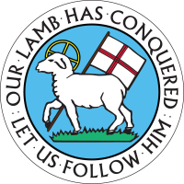
On this Second Sunday of Advent, as we anticipate the coming of the Christ Child, we light the candle of peace.
Two candles are lit.

Slide 3
John the Baptist calls out in the wilderness, “Make straight the crooked paths and prepare the way of the Lord!”
The way of the Lord is right relationships, wholeness, and harmony for all people everywhere.

Slide 4
For those experiencing crooked and stony paths, may new ways be found that are smooth.
Jesus, we pray that you will guide our feet into
the path of peace.

Slide 5
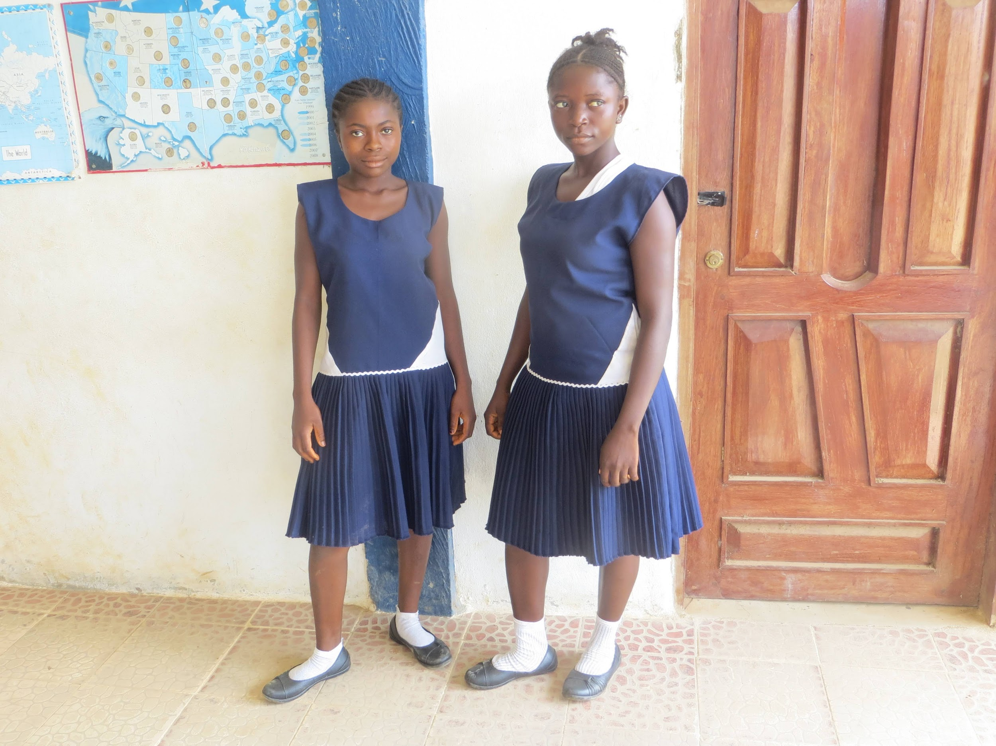
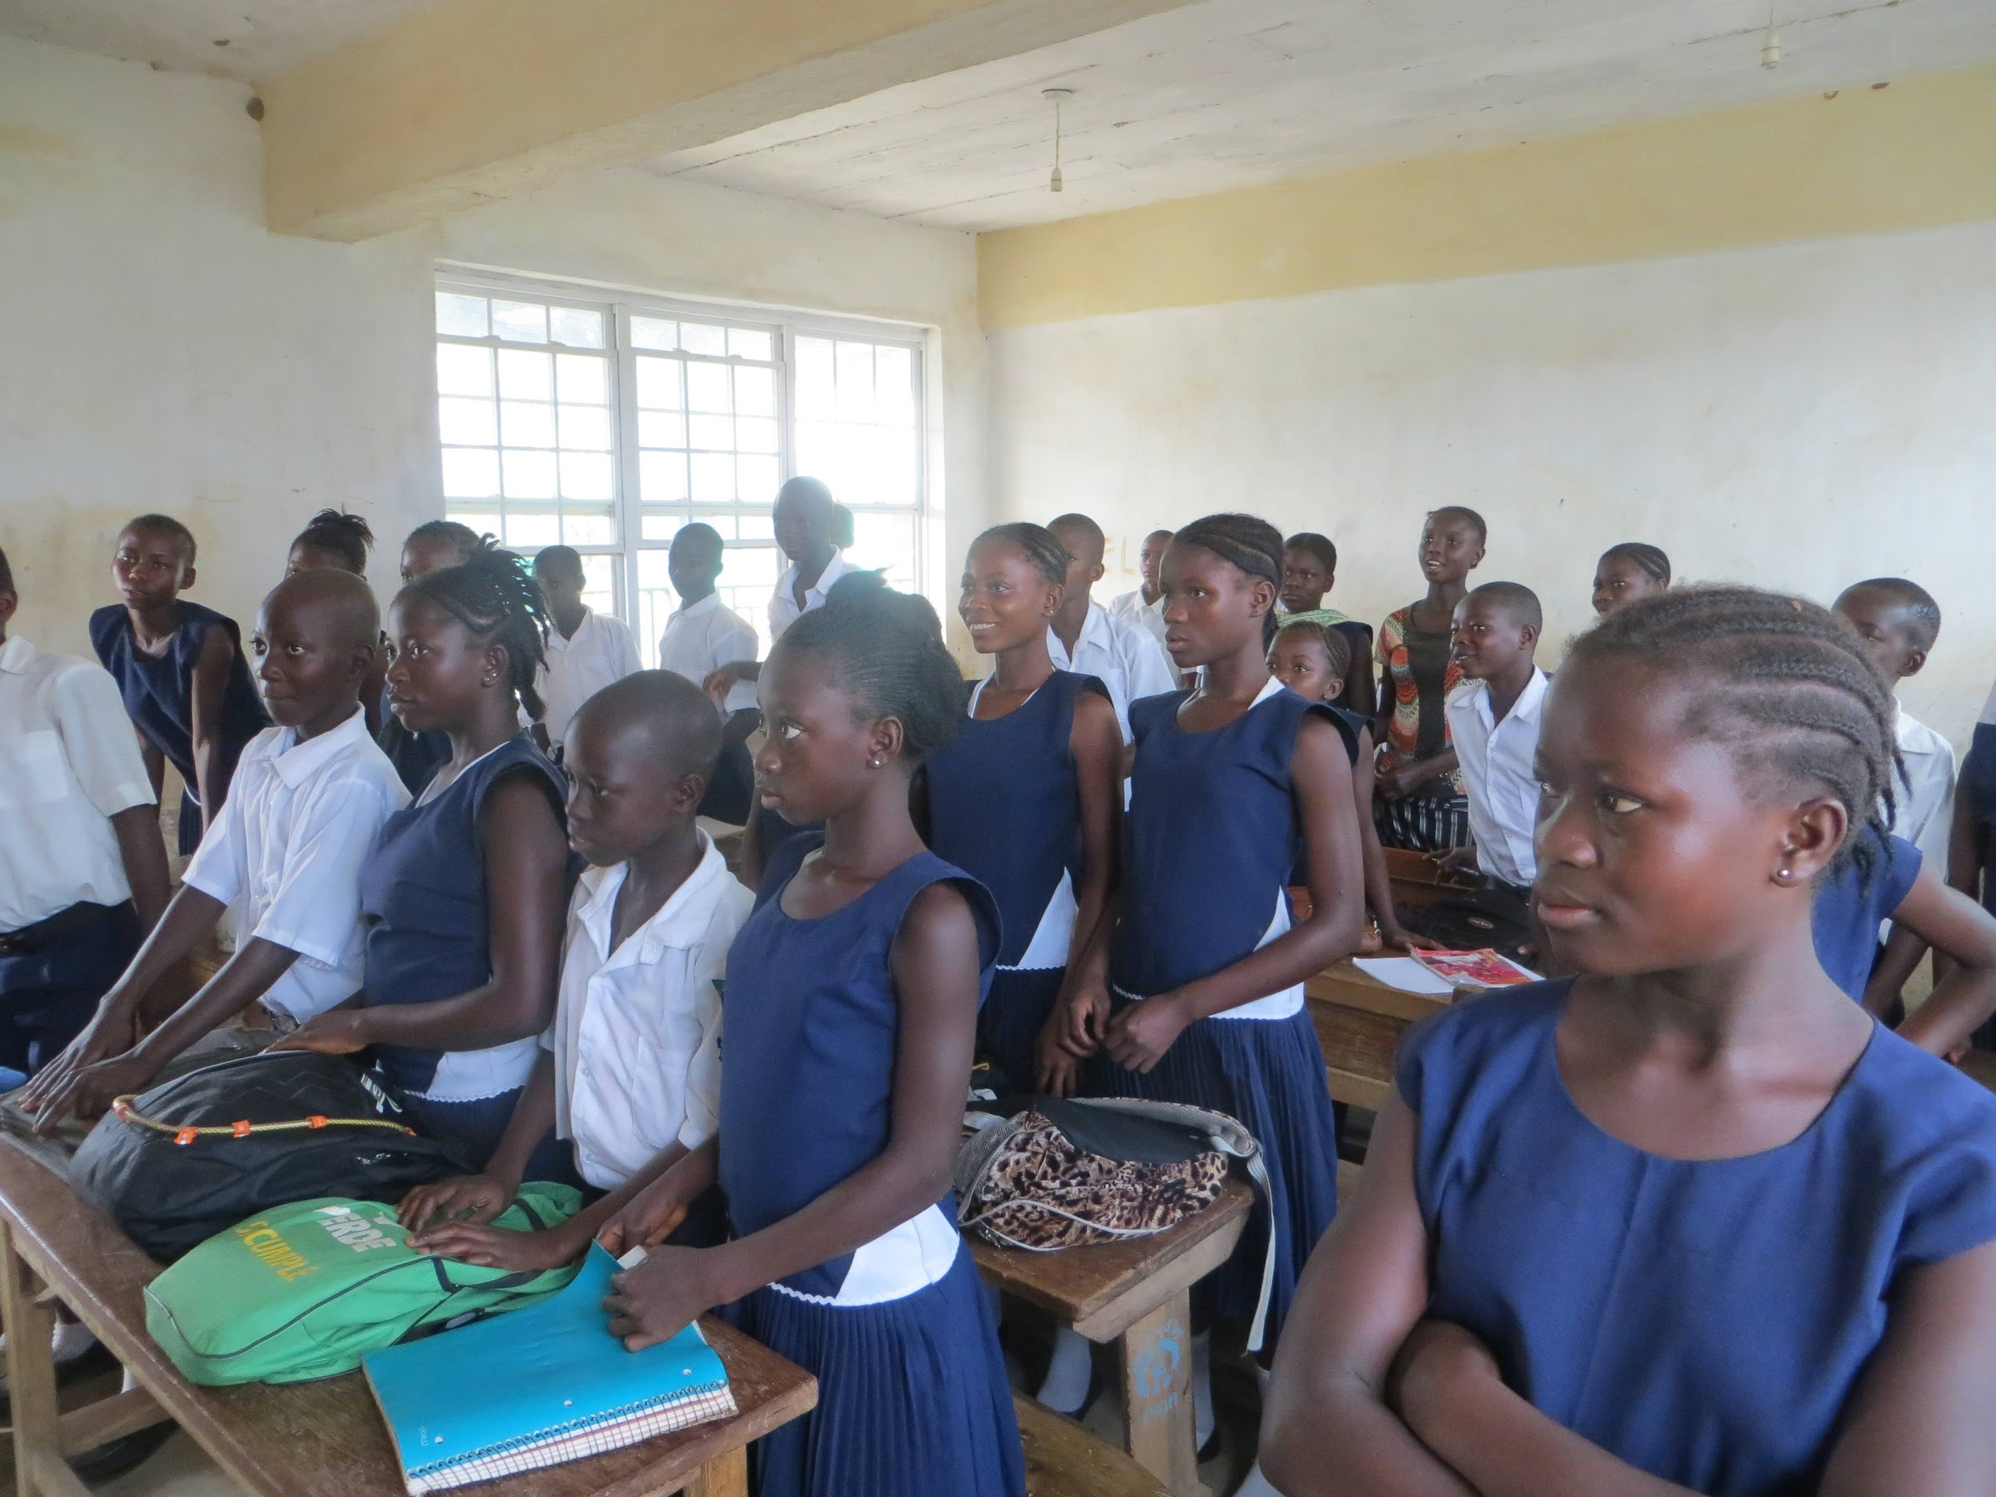
In Sierra Leone, young girls had to leave their villages to be educated. Away from home, without protection, young girls were vulnerable to abuse and worse. With the establishment of a Moravian School for boys and for girls, now children are safe, learning and thriving close to home.

Slide 6
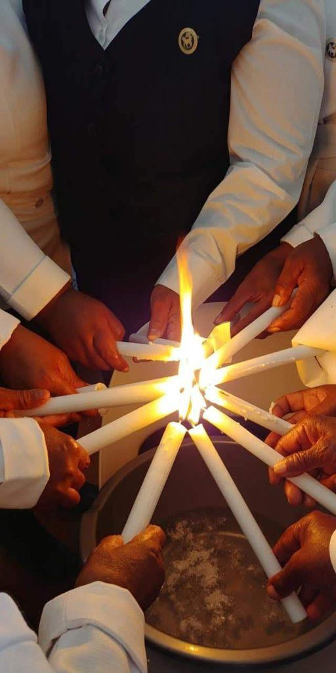
WeWe thank God for those who offer peace through protection.

Slide 7
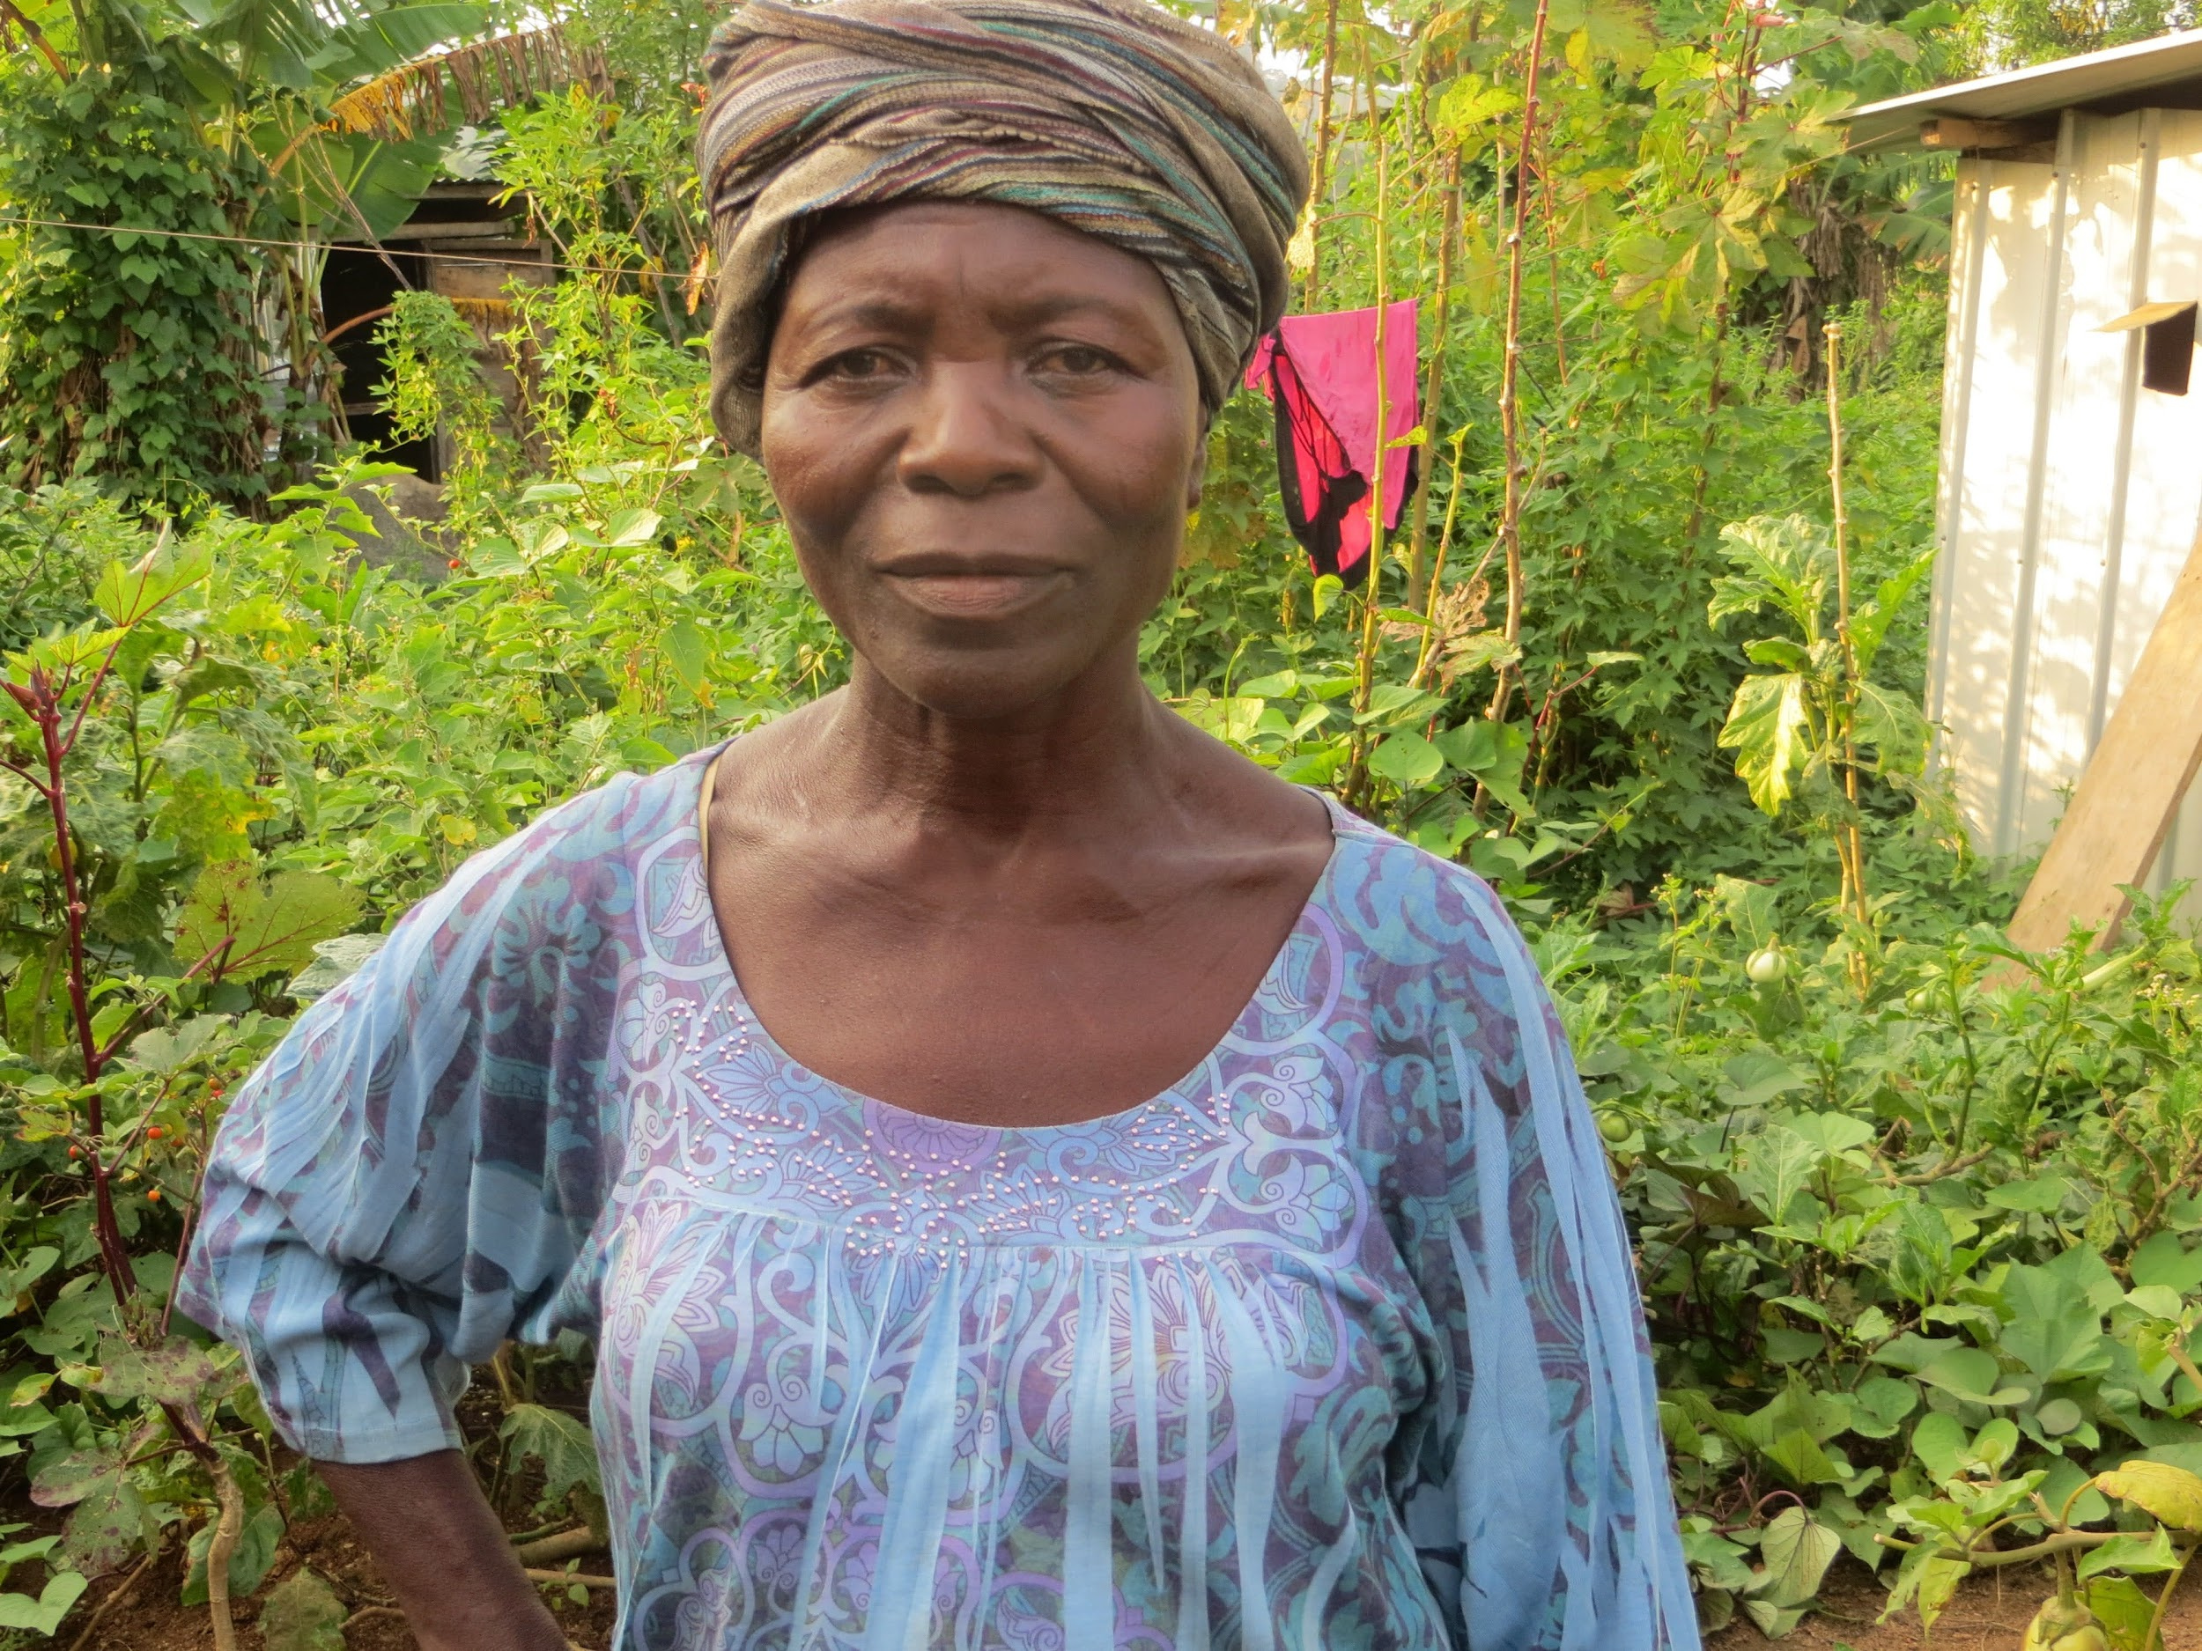
The global work of the Unity Women’s Desk develops congregational resources that equip people to advocate for both women who are suffering from violence and for changes in legal systems.

Slide 8
WeWe thank God for those who offer peace through protection.
We

Slide 9
In this time, our congregation celebrates the light of Peace in our community and
through our shared ministry:
(speak aloud the areas of ministry that offer protection for the vulnerable.)
And all God’s children say:
We thank God for those who offer peace through protection.

Slide 10
Hymn
St. Theodulph
The peace of our salvation is ours to fill our hearts.
Christ came to dwell among us and share our common plight.
The whole world’s grief and suff’ring and earth’s unspoken pain,
your perfect peace embraces till only hope remains.
(Adapted from #268 vs. 2 in the Moravian Book of Worship, Text by Paul Gerhardt, Tr. Jean Dogga Pearson © 1992. Used by permission of the Interprovincial Board of Communication.)

Slide 11
We pray today for all God’s children,
That each one might know the hope, peace, joy, and love that comes from God through the Advent of the Christ Child. Amen.

